Slide 1
Regression: Contact Session 3
Dr. Chetana Gavankar, Ph.D,
IIT Bombay-Monash University Australia
Chetana.gavankar@pilani.bits-pilani.ac.in

Slide 2
Contact Session 3
Date – 19/04/2020
Time – 10am to 12pm

Slide 3
Topics to be covered
Module 3: Assessing Accuracy of Simple Linear Regression Models
Probability Foundations 1 – Discrete probability distributions
Probability Foundations 2 - Continuous probability distributions, normal distribution and t distributions
Accuracy of the coefficient estimates of the simple linear regression models
Dependency of the dependent variable (target) variable on the independent variable (feature)
Accuracy of the simple regression model – RSE
Accuracy of the simple regression model – R^2

Slide 4
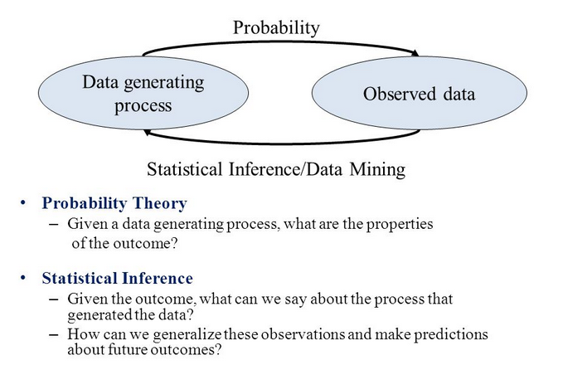
Probability Theory

Slide 5
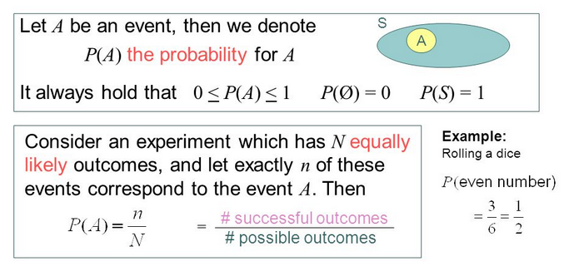
Probability Theory

Slide 6
Random Variable
A random variable, usually written X, is a variable whose possible values are numerical outcomes of a random phenomenon or experiment.
Examples
X = number of heads when the experiment is flipping a coin 20 times.
C = the daily change in a stock price.
R = the number of kilometers per litre you get on your car during a family vacation.

Slide 7
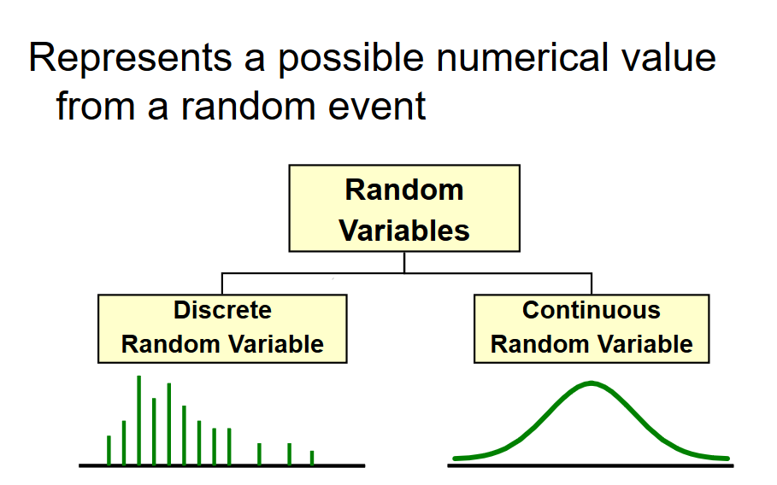
Random Variable

Slide 8
Random Variable
Discrete Random Variable
one that takes on a countable number of values
usually count data [Number of]
list all possible outcomes without missing any of them
Example:
X = sum of values on the roll of two dice:
X has to be either 2, 3, 4, …, or 12.
Y = number of students in AIML
Y has to be 100,120,140,180,200 …………

Slide 9
Random Variable
Continuous Random Variable
Variable that takes on an uncountable number of values
Usually measurement data [time, weight, distance, etc]
You can never list all possible outcomes even if you had an infinite amount of time
Example:
X = time it takes you to drive home from work place: X > 0, might be 30.1 minutes measured to the nearest tenth but in reality the actual time is 30.10000001…………………. minutes?)

Slide 10
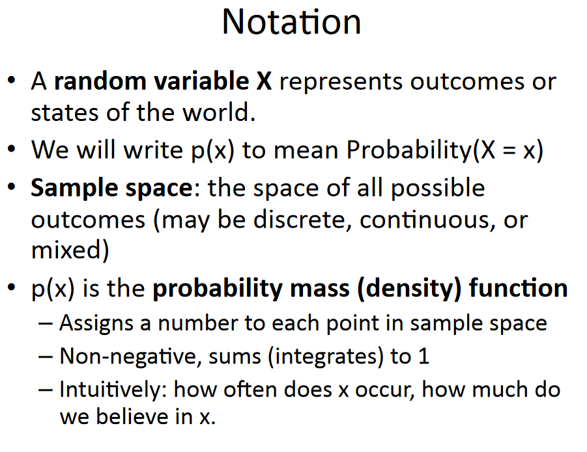
Probability Theory

Slide 11
Discrete Probability Disribution
A probability distribution (density function) is a table, formula, or graph that describes the values of a random variable and the probability associated with these values.
Discrete Probability Distribution
X = outcome of rolling one die
Discrete Probability Notation…
An upper-case letter will represent the name of the random variable, usually X.
Its lower-case counterpart, x, will represent the value of the random variable.
The probability that the random variable X will equal x is:
P(X = x) or more simply P(x)
X = number of heads in 10 flips of coin
P(X = 5) = P(5) = probability of 5 heads (x) in 10 flips

Slide 12
Computing Mean, Variance, and Std. Dev. for Discrete Random Variable
Example A mutual fund sales person knows that there is 20% chance of closing a sale on each call she makes. What is the probability distribution and mean of the number of sales if she plans to call three customers?
Solution:
Random Variable = X = # Sales Made in 3 Attempts
Let S denote the event of closing a sale P(S)=.20
Thus S^{C} is the event of not closing a sale, and P(S^{C})=.80
Seems reasonable to assume that sales are independent.

Slide 13
Developing Discrete Probability Distributions
Sample Space: List of all possible outcomes
SSS : P(X = 3) = (.2)*(.2)*(.2) = 0.008
P(3) = .008
SSS^{C} : P(X = 2) = (.2)*(.2)*(.8) = 0.032
SS^{C}S : P(X = 2) = (.2)*(.8)*(.2) = 0.032
S^{C}SS : P(X = 2) = (.8)*(.2)*(.2) = 0.032
P(2) = .032+.032+.032 (Additive Law)
SS^{C}S^{C} : P(X = 1) = (.2)*(.8)*(.8) = 0.128
S^{C}SS^{C} : P(X = 1) = (.8)*(.2)*(.8) = 0.128
S^{C}S^{C}S : P(X = 1) = (.8)*(.8)*(.2) = 0.128
P(1) = .128+.128+.128
(Additive Law)
S^{C}S^{C}S^{C} : P(X = 0) = (.8)*(.8)*(.8) = 0.512
P(0) = .512
X | 0 | 1 | 2 | 3
P(x) | 0.512 | 0.384 | 0.096 | 0.008

Slide 14
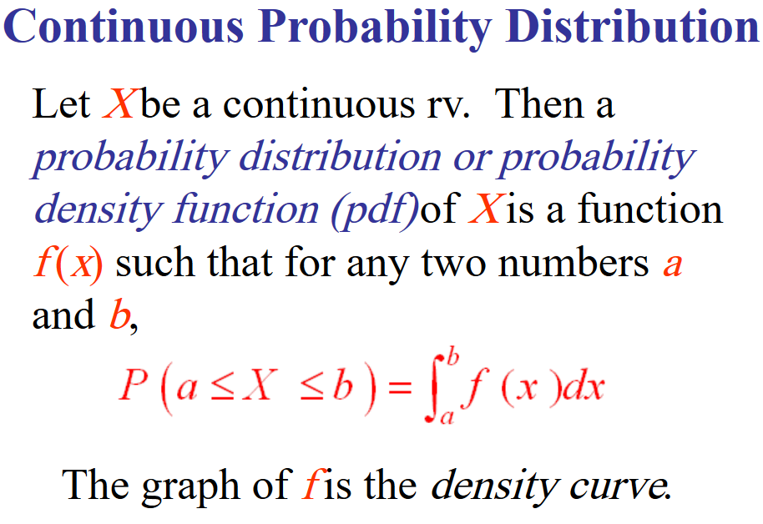
Probability Densities

Slide 15
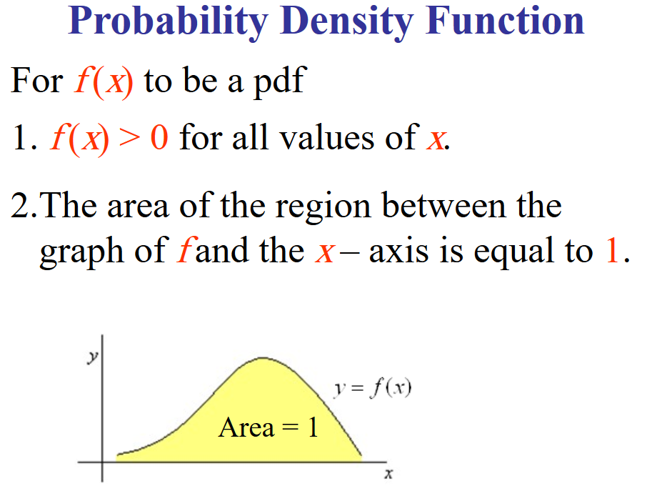
Probability Densities

Slide 16
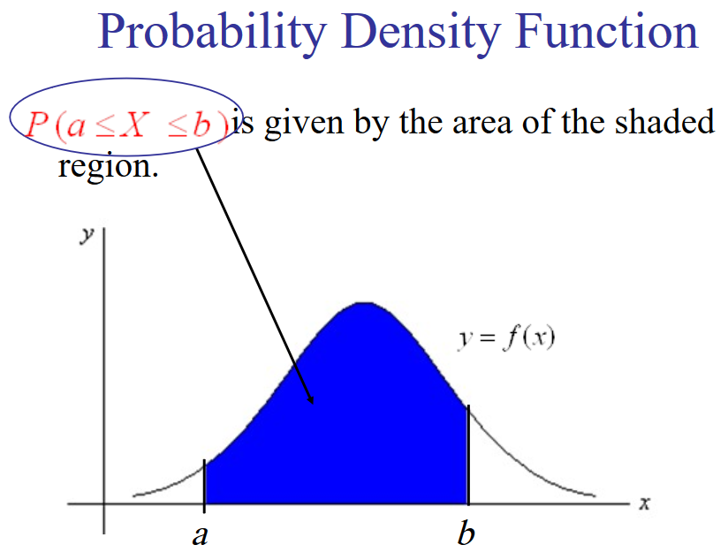
Probability Densities

Slide 17
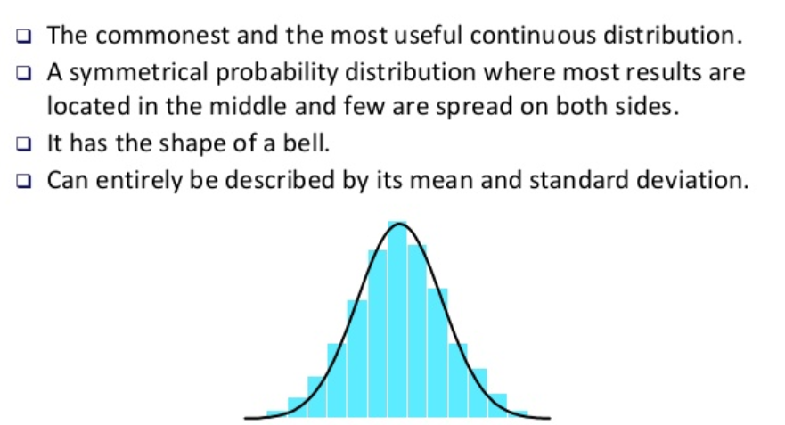
Gaussian Distribution

Slide 18
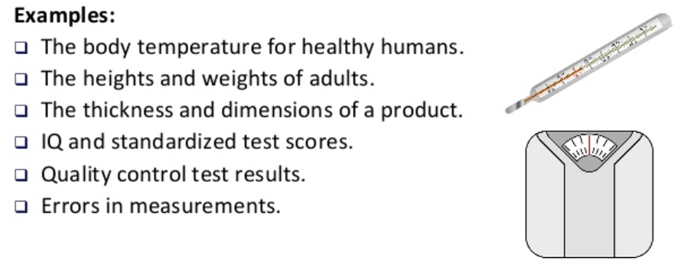
Gaussian Distribution

Slide 19
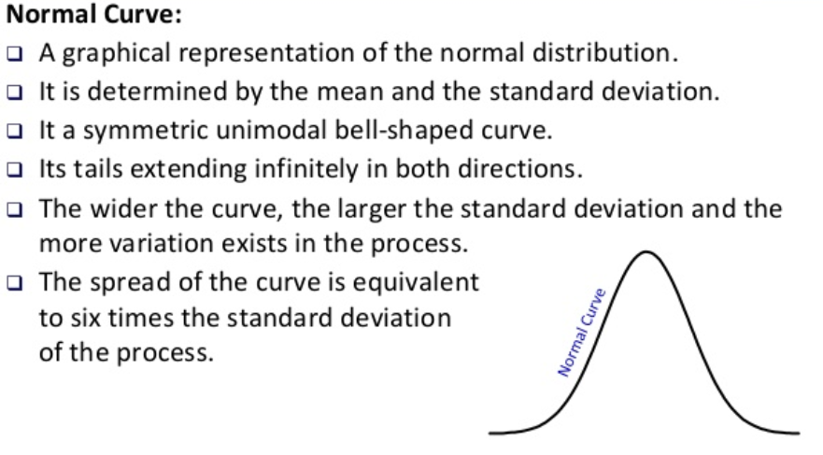
Gaussian/Normal Distribution

Slide 20
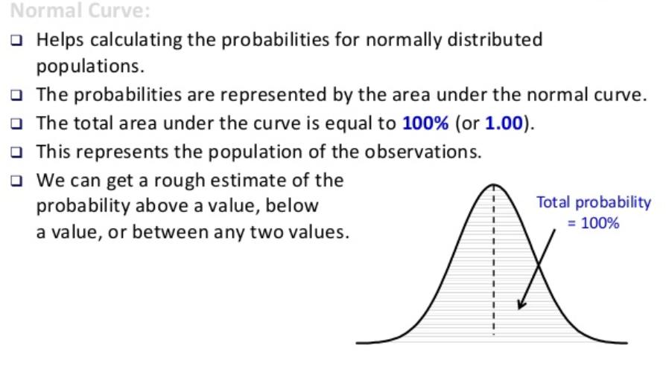
Normal Distribution

Slide 21
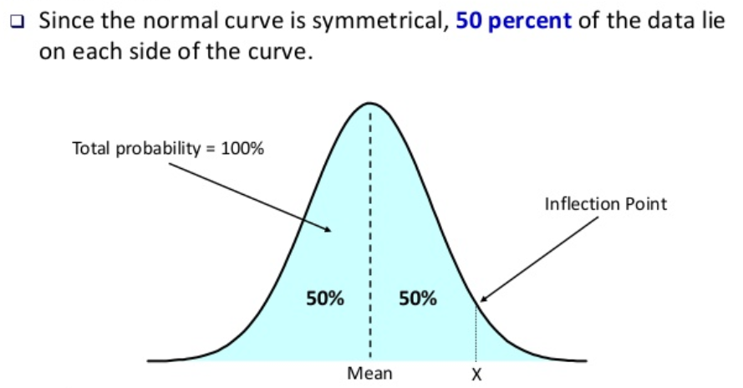
Normal Distribution

Slide 22
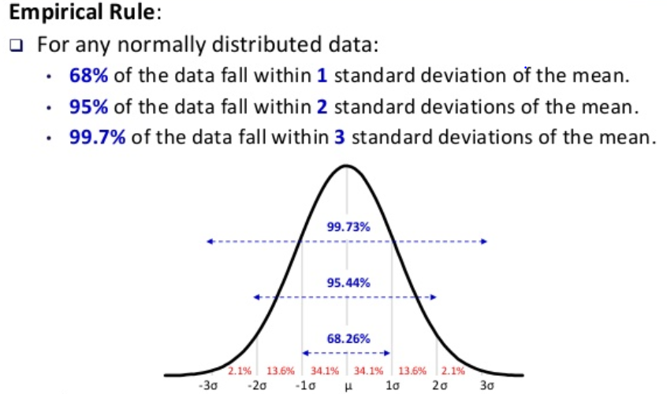
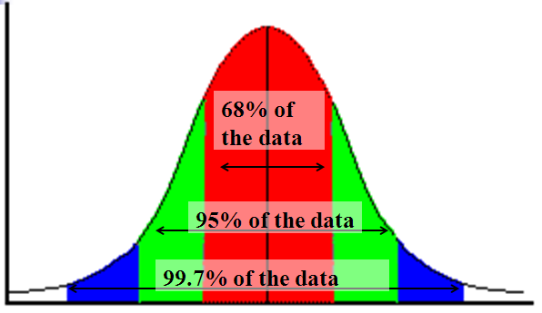
Normal Distribution

Slide 23
Normal Distributions
68-95-99.7 Rule in Math terms…

Slide 24
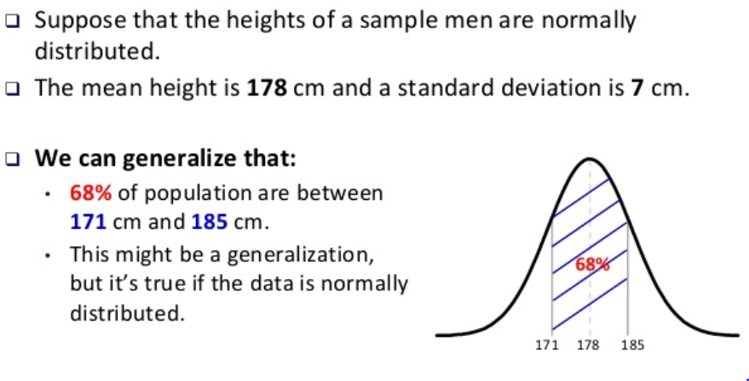
Normal Distribution

Slide 25
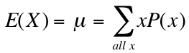
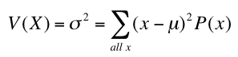
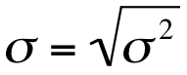
Mean, Variance & Standard Deviation
The mean of a discrete random variable is the weighted average of all of its values. The weights are the probabilities.
This parameter is also called the expected value of X and is represented by E(X).
The variance is
The standard deviation is

Slide 26
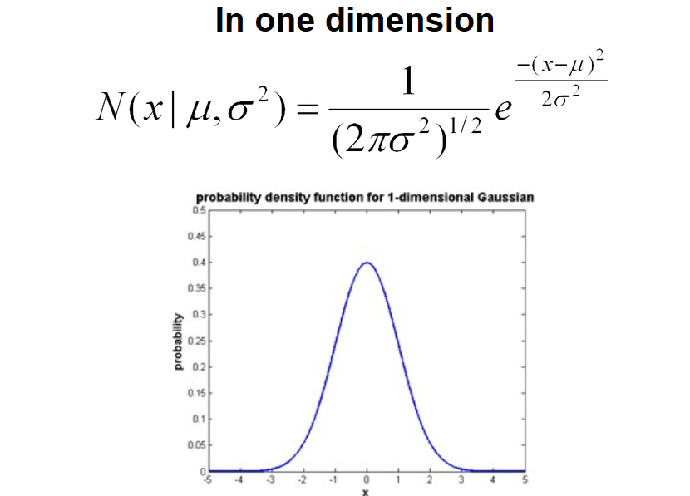
Normal Distribution

Slide 27
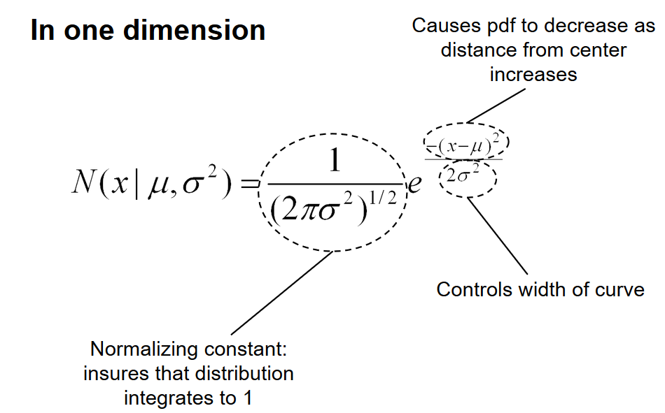
Normal Distribution

Slide 28
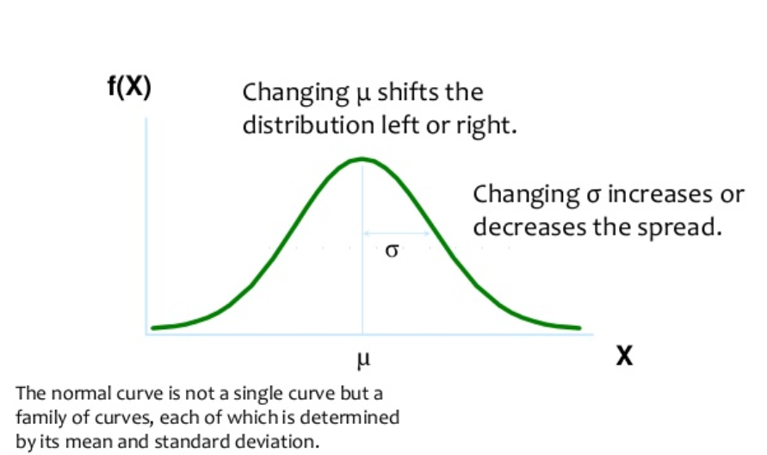
Normal Distribution

Slide 29
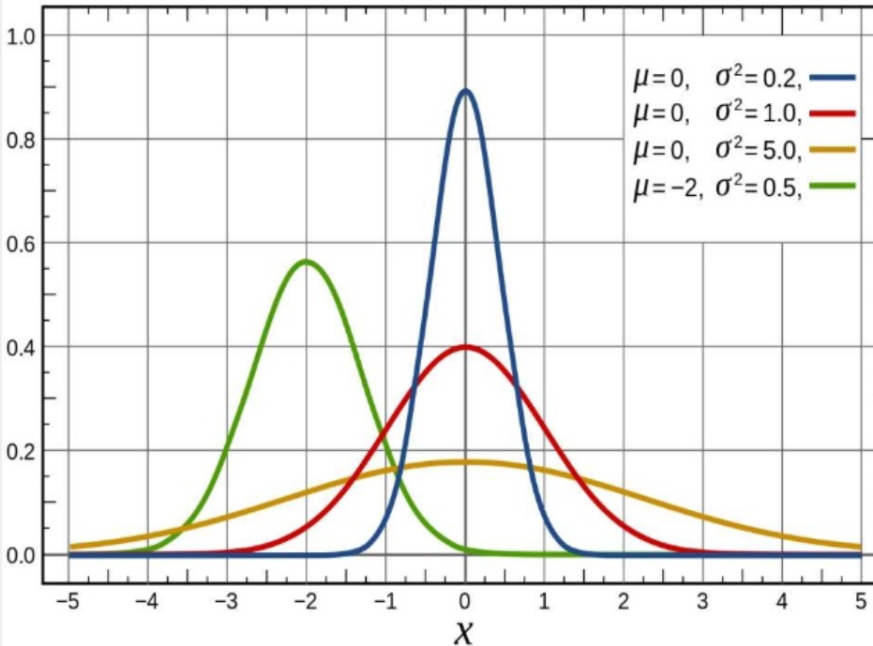
Normal Distribution

Slide 30
Degrees of Freedom
Number of degrees of freedom is the number of values in the final calculation of a statistic that are free to vary

Slide 31
t-distribution
Student's t-distribution (or simply the t-distribution) is any member of a family of continuous probability distributions that arises when estimating the mean of a normally distributed population in situations where the sample size is small and the population standard deviation is unknown

Slide 32
t-statistics
Pick any probability distribution and specify a mean and standard deviation.
T-statistics:
Notes:
IF the true mean was 128 with an average variability of 15 lbs….

Slide 33
t distribution
The t distribution has the following properties:
The mean of the distribution is equal to 0 .
With infinite degrees of freedom, the t distribution is the same as the standard normal distribution.

Slide 34
When to Use the t Distribution
The t distribution can be used with any statistic having a bell-shaped distribution (i.e., approximately normal).
The sampling distribution of a statistic should be bell-shaped
The population distribution is normal.
The population distribution is symmetric

Slide 35
T-distribution problem
Suppose scores on an IQ test are normally distributed, with a population mean of 100. Suppose 20 people are randomly selected and tested. The standard deviation in the sample group is 15. What is the probability that the average test score in the sample group will be at most 110?
(https://stattrek.com/probability-distributions/t-distribution.aspx)

Slide 36
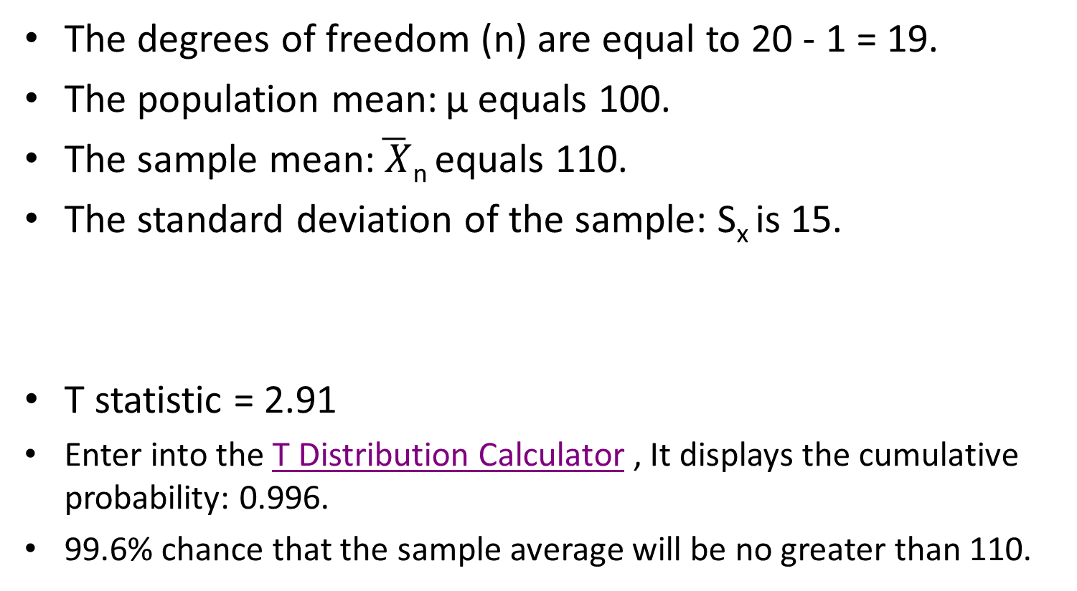
T-distribution problem Solution:
The degrees of freedom (n) are equal to 20 - 1 = 19.
The population mean: µ equals 100.
The sample mean:$\overline{ X}$_{n} equals 110.
The standard deviation of the sample: S_{x} is 15.
T statistic = 2.91
Enter into the T Distribution Calculator , It displays the cumulative probability: 0.996.
99.6% chance that the sample average will be no greater than 110.

Slide 37
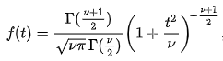
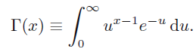
t Distribution
A random variable T with probability density function
is said to have a t distribution with v degrees of freedom and (gamma) is the Gamma function defined by

Slide 38
t Distribution
Standard Normal
(t with df = ∞)
t (df = 13)
t-distributions are bell-shaped and symmetric, but have ‘fatter’ tails than the normal
t (df = 5)
t

Slide 39
t Distribution
Upper Tail Area
Let: n = 3 df = n - 1 = 2 α = .10 α/2 =.05
df
.25
.10
.05
1
1.000
3.078
6.314
2
0.817
1.886
2.920
3
0.765
1.638
2.353
α/2 = .05
The body of the table contains t values, not probabilities
0
2.920
t
N= number of samples
α (alpha) = probability

Slide 40
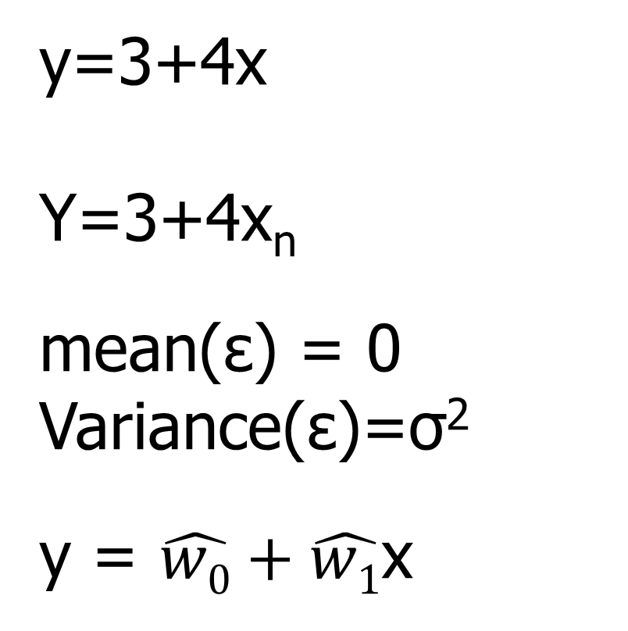
Unbiased Estimators
y=
y=3+4x
Y=3+4x_{n}
mean(ε) = 0
Variance(ε)=σ²
y = $\hat{w0}+\hat{w1}$x

Slide 41
Unbiased Estimators
Unbiased estimate when expectation of sample mean is same as population mean

Slide 42
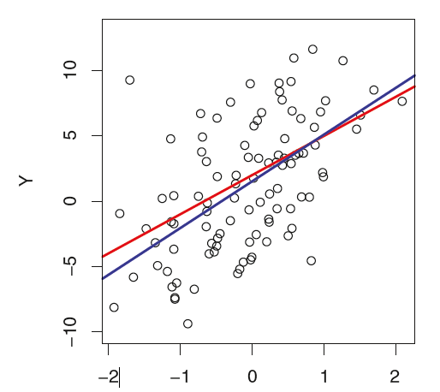
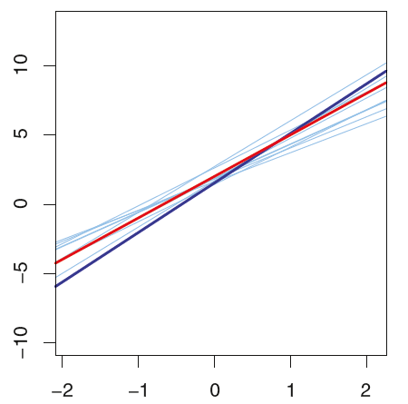
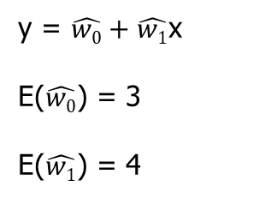
Unbiased Estimators
y=3+4x
y = $\hat{w0}+\hat{w1}$x
E($\hat{w0}$) = 3
E($\hat{w1}$) = 4
The error which tends to cancel out in the long run are called unbiased error

Slide 43
Unbiased Estimators: Standard Error(SE)
N= Number of input samples
N-2 degrees of freedom (two parameters in simple linear regression model)

Slide 44
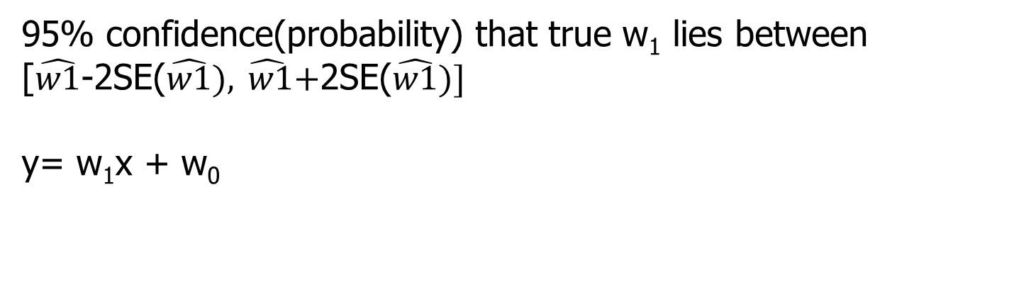
Unbiased Estimators
95% confidence(probability) that true w₁ lies between
[$\hat{w1}$-2SE($\hat{w1}),\hat{ w1}\text{+}\text{2}\text{SE}\text{(}\hat{w1})]$
y= w₁x + w₀

Slide 45
Relationship between dependent and independent variable
H₀: There is no relation between x and y (null hypothesis)
H₁: There is relationship between x and y
Mathematically
H₀ implies w₁ = 0
H₁ implies w₁ not = 0

Slide 46
Relationship between dependent and independent variable

Slide 47
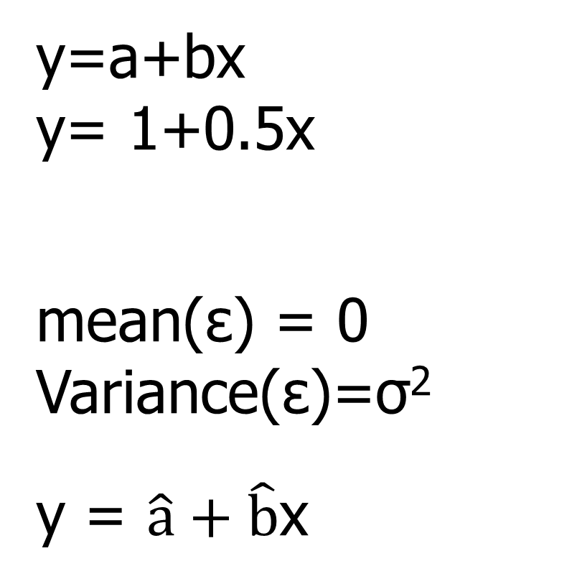
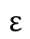
Linear Regression
y=a+bx
y= 1+0.5x
mean(ε) = 0
Variance(ε)=σ²
y = $\hat{a}+\hat{b}$x
$$ε$$

Slide 48
Linear Regression
y=a+bx
y= 7.15+1.95x
mean(ε) = 0
Variance(ε)=σ²
$$ε$$
 | Coefficient | Std. error | t-statistic | p value
Intercept | 7.15 | 0.56 | 12.76 | <0.01
Advt. | 1.95 | 0.12 | 16.25 | <0.01

Slide 49
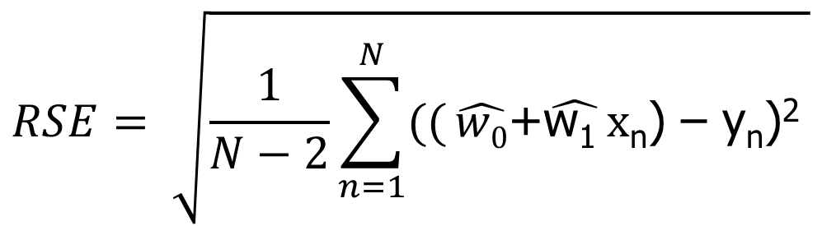
Residual Standard Error (RSE) UNBIASED ESTIMATE
N= Number of input samples
mean(ε) = 0
Variance(ε) = σ²
$$RSE= \sqrt{\frac{1}{N−2}\sum_{n=1}^{N}{((}\hat{w0}\text{+}\hat{\text{w}\text{1 }}x\text{n}\text{) – }\text{yn}\text{)}\text{2} }$$
RSE is Unbiased estimate of sigma σ

Slide 50
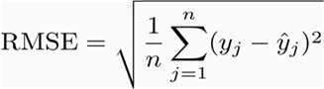
Root-mean-square error (RMSE) BIASED ESTIMATE
Root-mean-square deviation (RMSD) or RMSE
Measure of the differences between values (sample or population values) predicted by a model and the values observed
RMSE gives a relatively high weight to large errors
Useful when large errors are particularly undesirable
If you are trying to compare two models/estimators, then there is no significance to the square root.
Square root - trying to plot the error in terms of the same units as you made the estimators

Slide 51
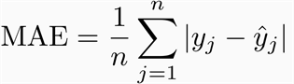
Mean Absolute Error (MAE) BIASED ESTIMATE
Mean Absolute Error (MAE): MAE measures the average magnitude of the errors in a set of predictions

Slide 52
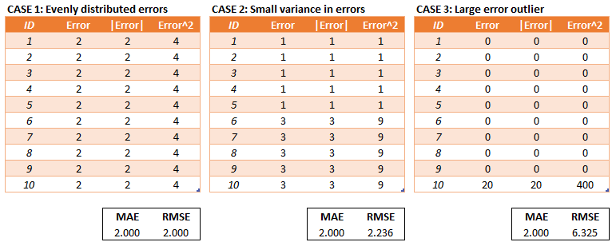
Linear Regression Error Function

Slide 53
R^2 Error - BIASED ESTIMATE
Advertising (in lakhs of rupees) | Sales (in lakhs of rupees)
10 | 520
20 | 625
35 | 700
50 | 780
20 | 605
Predicting sales of an item
Variability without considering the independent variable is much more than the variability considering the dependent variable. i.e TSS >> RSS

Slide 54
Accuracy of the simple regression model – R^2
Predicting sales of an item
Advertising (in lakhs of rupees) | Sales (in lakhs of rupees)
10 | 520
20 | 625
35 | 700
50 | 780
20 | 605
Out of total variability TSS,
after building regression model using dependent variable the
R² is calculated as
R² = (TSS - RSS / TSS)
An unbiased estimate is one that is just as likely to be too high as it is to be too low, and it is correct on average. If you collect a random sample correctly, the sample mean is an unbiased estimate of the population mean.
A biased estimate is systematically too high or low, and so is the average.

Slide 55
Good References
https://www.youtube.com/watch?v=JU5yHa8Jd0Y
https://www.youtube.com/watch?v=hV4pdjHCKuA
https://stats.stackexchange.com/questions/241963/r-squared-a-biased-estimate-because-its-systemtically-too-high-or-low
Degrees of freedom
https://www.youtube.com/watch?v=92s7IVS6A34
https://www.youtube.com/watch?v=N20rl2llHno

Slide 56
Thank You
18 April 2020

